Slide 1
CNN for handwritten alphabets
14010994 Computer Engineering Yeongjoon Ju
14011870 Computer Engineering Kiwon Seo

Slide 2
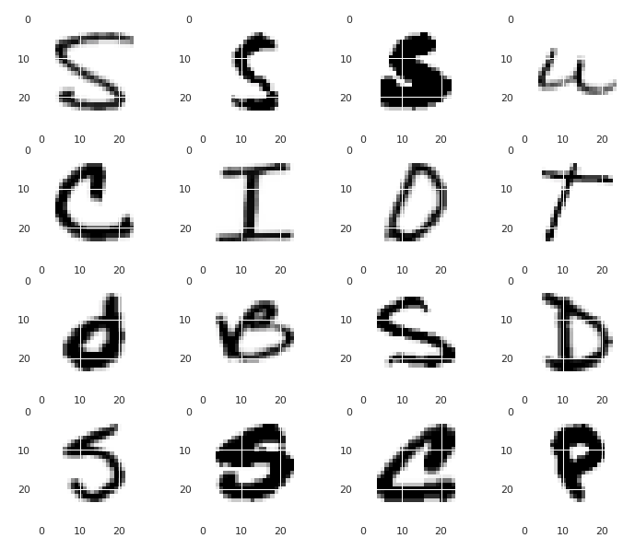
Load MNIST dataset
Download from : https://www.kaggle.com/sachinpatel21/az-handwritten-alphabets-in-csv-format#A_Z%20Handwritten%20Data.zip

Slide 3
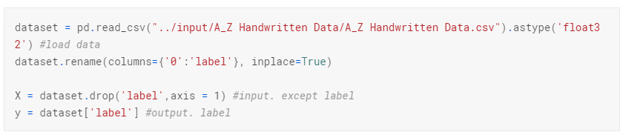
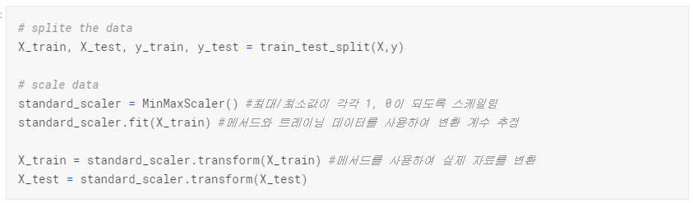
Load dataset
Load Data
Split data
Train : 279337 samples Validate : 93113 samples

Slide 4
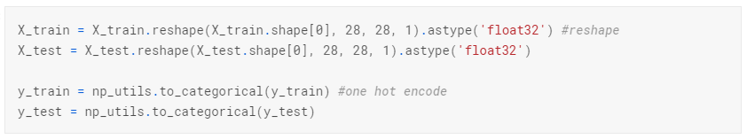
Load dataset
One-hot encoding

Slide 5
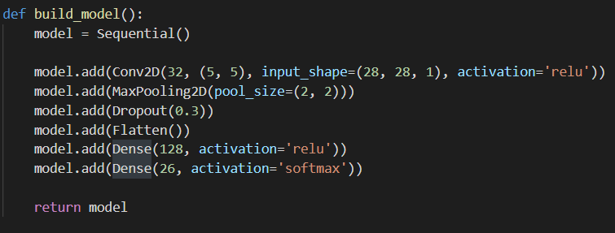
Create Model
kernel
(5,5)
kernel
(2,2)
0.7
Fully
32
32
(26)
(N, 28, 28, 1)
(128)

Slide 6
CNN
Accuracy : 99.4%
Train : 279337 samples Validate : 93113 samples
Epochs : 20 Batch_size : 200 Optimizer : adam
Metric : accuracy

Slide 7
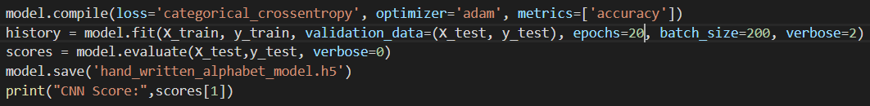
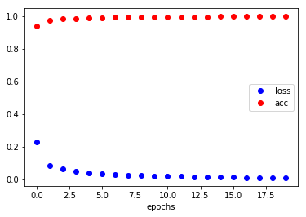
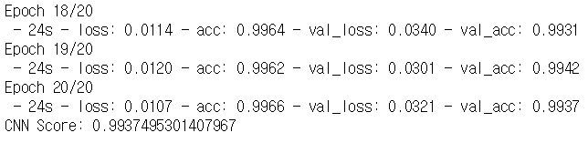
Train and Evaluate Model
The highest validation accuracy is 99.42%!!!

Slide 8
Conclusion
We use only one convolution layer and two fully-connected layer
So, The simple is Best!!

Slide 9
Q&A

